Slide 1

Building a strong territorial brand
cases from the alpine area
Prof. Manu Broccard (CH)
EtnoCarpathia workshop PL / SK – september 2020

Slide 2
Dzień dobry i dziękuję za zaproszenie mnie tutaj

Slide 3
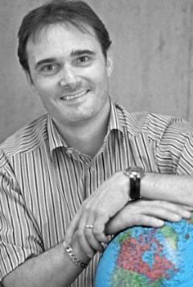


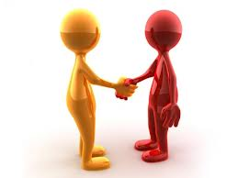
A short introduction :
Prof. Manu BROCCARD (CH)
  Education :
    MBA in Tourism Management (IUKB- HEC Lausanne)
    Gestionnaire en Tourisme (HES-SO)
    Quality manager (Q1 FST)
    English (C2) – German (B2) – French (Mother tongue)
  Professional experience :
    HES-SO Valais – Prof HES (10y.)
    Economic Researcher at the Institute of Toursim
    Professor at the Faculty of Tourism
    Swiss School of Tourism – Director (3y.)
    DMO ‘Cœur du Valais’ – Director (5y.)
    Sion Région + Sierre-Anniviers Tourisme
    13 OT / 21 communes / 2,2 mio overnights
    Valais Tourism
    Product-marketing manager (5y)
    OT Thyon - 4Vallées
    Director of Tourism (3y)
    Fert Tours Int’l
    Incoming agent - TO – Geneva (1y)
    Isle of Wight Tourism – UK (6m)
    Marketing internship
  Honneurs / commissions :
    Medal of Merit in Tourism
    Polish Ministery of Tourism (2016)
    Member of the “Swiss Tourism Council”
    at Switzerland Tourism : 2010 - 2013
    Member of the ’Board of Directors’
    at Valais Tourism : 2010 - 2013
    Member of the ‘Foundation council’
    at University IUKB – Sion : 2010-2013

Slide 4
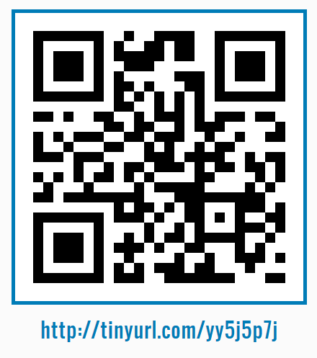
E-vote

Slide 5
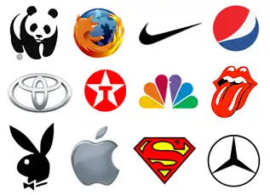
How many of these brands do you recognise ?
Notes:
WWF Firefox Nike Pepsi
Toyota Texaco CNBC Rolling Stones
Playboy Mac (Apple) Superman Mercedes

Slide 6
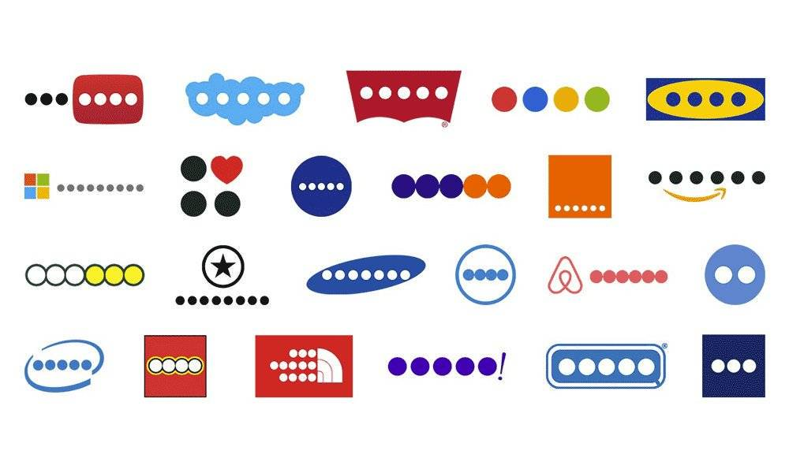

Can you recognise them without their name ?
Notes:
Ecrivez sur un papier toutes les marques que vous reconnaissez
You Tube Skype Levis Google IKEA
Microsoft New-York Nivea FedEx Orange Amazon
Subway Converse Samsung Dell Airbnb H-D (dessous : Motorola)
Intel Lego North Face Yahoo durex GAP

Slide 7
WHY can we recognise these signs / logos / brands so easily ?
Notes:
Longevity
Budget in communication
Personality

Slide 8
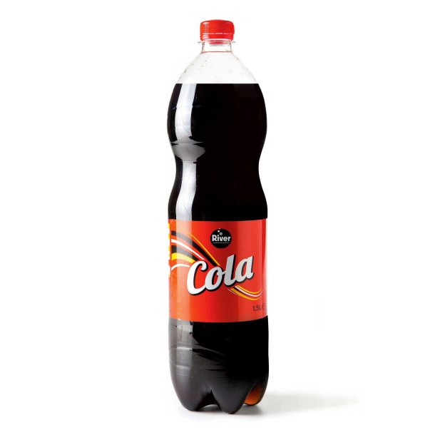
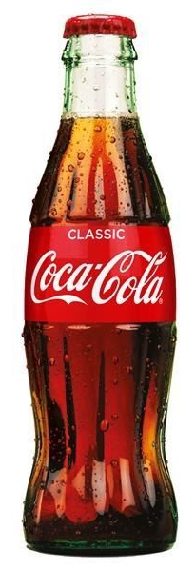
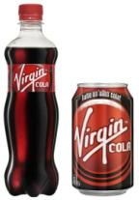
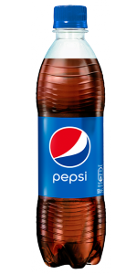
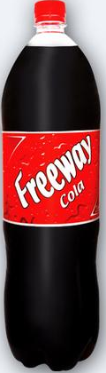
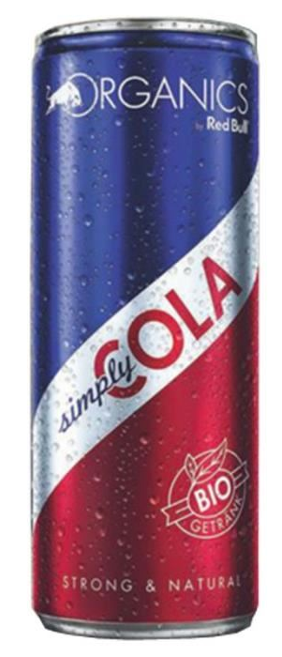
Vote – which ‘cola’ would you buy ?
Every bottle contains 0,5l (prices in PLZ)
1
2
3
4
5
6
2,20
2,10
3,70
4,00
3,40
3,90
Notes:
Use post its to stick to each answers
1 Freeway Cola – Lidl
2 River Cola ?
3 Red Bull Cola
4 Coca Cola
5 Virgin Cola
6 Pepsi

Slide 9
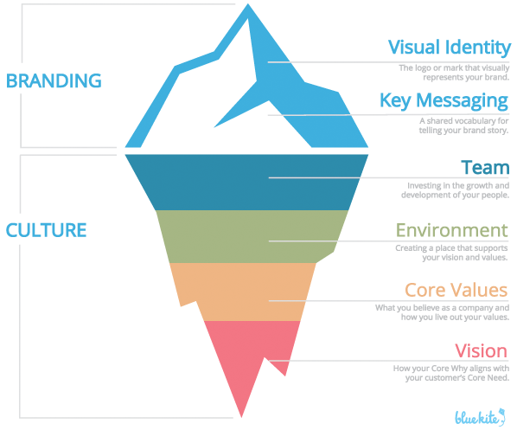
True Branding
Source : Click Laura (2019), Bluekite marketing
Notes:
https://flybluekite.com/rename-your-business/culture-branding-iceberg-graphic-2/
Vision -> What do you want to achieve ? Where do you want to go ?
Core Values -> What do you believe in ? What do you want to support ?
Environment -> The element of your brand and its personality
Team -> Gain the trust and support of all stakeholders
Only then will you be able to :
Key messaging -> position your brand, create a slogan and a key message
Visual identity -> Decide on your colours, shapes, logo, pictures

Slide 10
Developping your brand
Ideally, you're questioning yourself regarding your brand strategy, as well as what those questions mean.
Who are you ?
  What is my brand purpose ?
  What is my brand vision ?
  What is my brand mission ?
  What are my brand values ?
How do I define my brand personality ?
  Voice, tone, shape, colours,…
Source : Adido-digital UK, (2020), internet blog
Notes:
Who are you?
Existential shizzle, I know, but absolutely paramount in crafting your branding strategy.
Generally, understanding who you are as a company requires reflection on four things.
Your purpose.
Your vision.
Your mission.
Your values.
Many will struggle reflecting on these concepts. So, what are they?
What is my brand purpose?
Consider why you formed the company in the first place, condense that consideration and voilà.
What is my brand vision?
Your vision should inform you where you're heading, reminding you of everything you're going to achieve. It should be something that unites and motivates the team around you and drives change.
What is my brand mission?
Your mission should summarise the reason you exist as a company. It should be the reason you love coming into work every day.
What are my brand values?
Your brand values are your principles. What do you stand for? Brand values are easy to get right. However, if you slip upholding them, repairing the damage can take time.
How do I define my brand personality?
Your brand personality should reflect your brand purpose and values.
Ask yourself, what would your brand be like if it were a person?
If you can visualise what your brand would look like as a person, and can then reflect that persons personality through the rest of your brand.
How do I define my brand voice?
Defining your brand voice is imperative when identifying your brand essence.
A good brand voice is distinct, unique, and irrefutably yours.
It should hold it's own within a digital sea of other content and voices.
Once you've settled on your brand voice, you must communicate it consistently in your copy to maintain credibility.
How do I define my brand tone?
Source : https://www.adido-digital.co.uk/blog/building-your-brand-strategy/

Slide 11

Brand management
A good brand is capable of inspiring TRUST to the clients and the stakeholders via
    The qualities of the company and its products
    The benefits for the client and stakeholders
    The values conveyed by the brand

Slide 12

Territorial brands
One of the biggest challenge of a territorial brand, and a compulsory one for success, is the UNIFICATION of all partners behind the idea and the values.
Clients will not be able to recognise and trust a brand if the values are not shared by all stakeholders
Notes:
Source image : https://www.caribbeanmuslims.com/unification

Slide 13
Information behind your brand
Positioning
To (targeted segments), our (brand) brings (concept) that allows/offers (axis of differentiation).
Research goal : Who is your audience, what do they need and
how are your serving them better & differently than every single other option available ?
Values & mission
What is your brand committed to, in order to achieve your vision in the future ?
Audience
Demographic
Psychogric
Comportmental
Geographic
Personality
Human psychology : 12 archetypes
Brand Idea
Source : Sumner Hobart, 2019, Branding workshop internet
Notes:
https://www.youtube.com/watch?v=L38N2huEc-c
Audience : Understanding your audience and competitors
Values and missions : Fundamental beliefs oupon which your business and its behaviors are based
Create a statement/sentence for each of your values
What is your brand committed to, in order to achieve your vision in the future ?
Position on the market - énoncé de positionnement
Personality – human like : Human psychology : 12 archetypes / We are – we are not / persona
Brand idea : Idea captured in a simple, meaningful phrase that expresses the essence of a brand (ex. Volvo : Safety / Starbucks : Reward everyday moments / Ben & Jerry’s : Linked prosperity)
DATA : Research on google or Review data,
Review sources : FB, Yelp, Amazon, Glassdoor, Trip Advisor, BBB, Foursquare

Slide 14
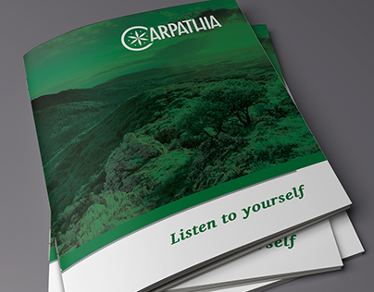

Carpathia brand
During its existence, the Polish Carpathian Euroregion association implemented more than 290 cross-boarder cooperation (CBC) projects. The most important was the “Carpathian Horizon 2020”, which was an attempt to prepare a macro regional strategy (MRS) on the European level similar like the EU strategy for the Danube region or the EU strategy for the Baltic Sea region.
The interesting project is “Carpathian Mark”, whose aim is create its own brand mark to promote the CER territory as a touristic destination
Source : Central European Service for Cross-Border initiatives (CESCI), 2015, Internet

Slide 15
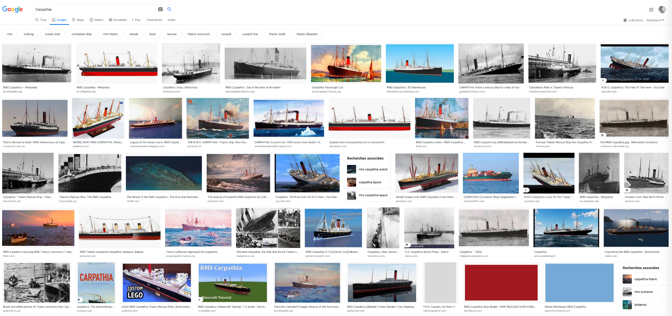
« Google » search for « Carpathia »
Notes:
A first search in ‘Google’ (14th september 2020)

Slide 16
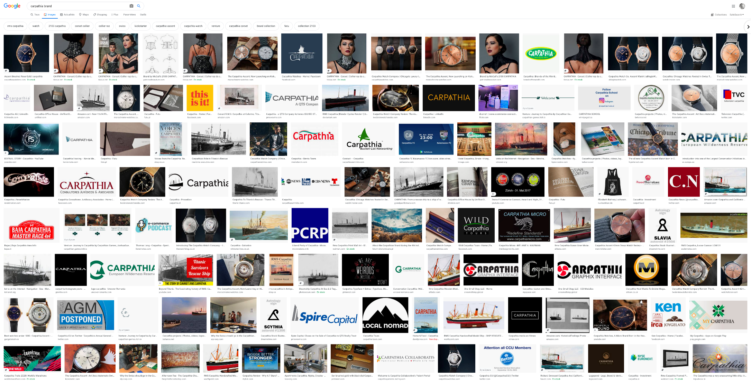
« Google » search for « Carpathian brand »

Slide 17
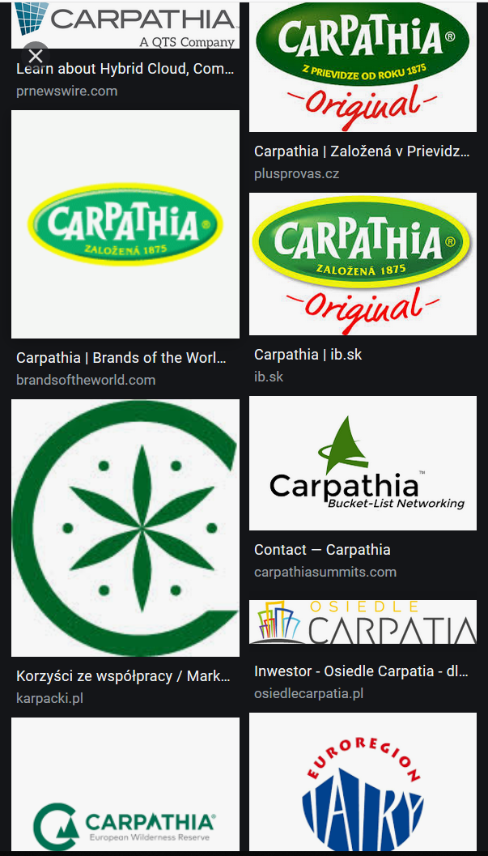
How many brands ?
Is an intersectorial brand the answer ?
Notes:
For economic and / or political reasons, this is certainly understandable. However, in the client’s point of view, this makes no sense.
Therefore the answer might be the ‘intersectorial brand’

Slide 18
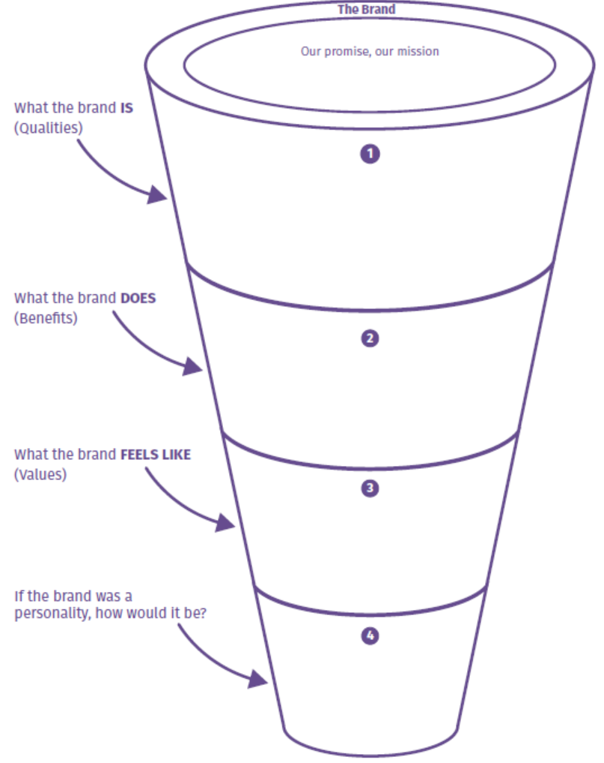
Your brand practical exercise
Can you define the essence of your brand ?
Please write down what this ‘brand’ represent to you ?
Notes:
Why this colour ?
Why this typography ?
Why this drawing ?

Slide 19
Notes:
Type of benefits for the client : Quality, Design/visuals, Experience, Origin, Social, Convenience

Slide 20


A practical exemple from the alpine area : the brand ‘VALAIS’

Slide 21
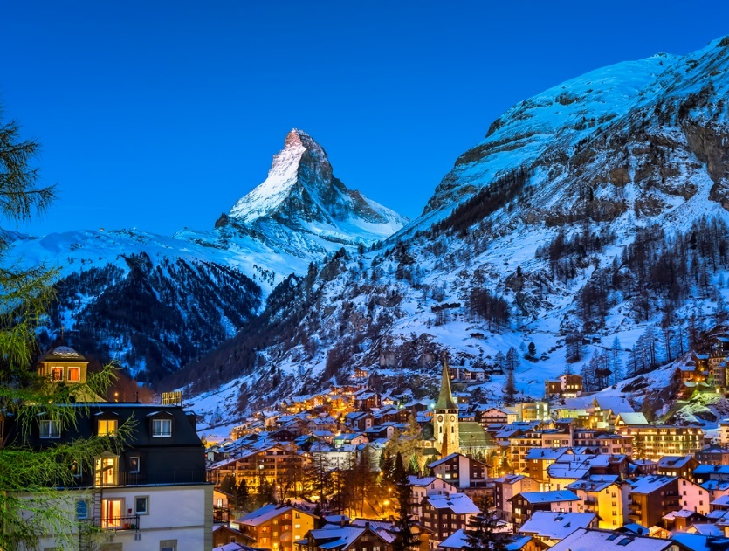
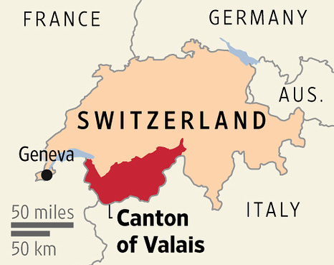
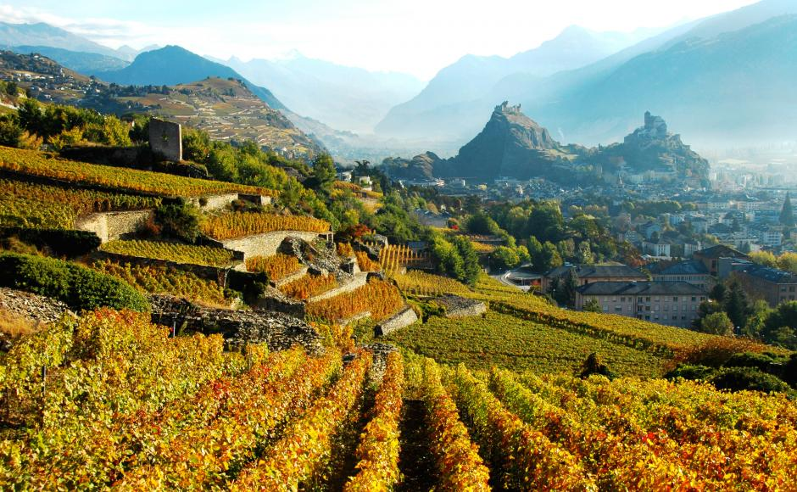
southern switzerland ‘dolce-vita’
Bordering France and Italy, the Valais region, in the heart of the Alps, sees a flourishing economy through its industry, agriculture and above all tourism, thanks to a very mild micro-climate.

Slide 22
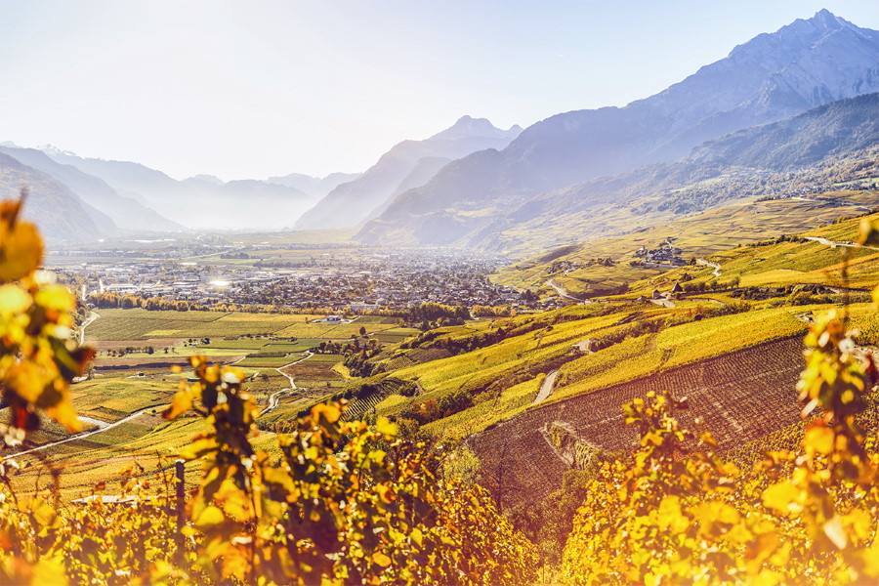
Many constraints and difficulties to unify
2 languages
Low valleys and high mountains
Many different economic sectors
  Agriculture
  Industry
  Wine
  Tourism

Slide 23




Before the process…
Notes:
In terms of brands…

Slide 24


AFTER the process…
A SHARED TERRITORIAL BRAND

Slide 25
The 'Valais' brand is a sign of recognition of origin and quality for emblematic Valais products.
The aim of this multisectoral brand is to promote Valais to consumers and guests.

Slide 26
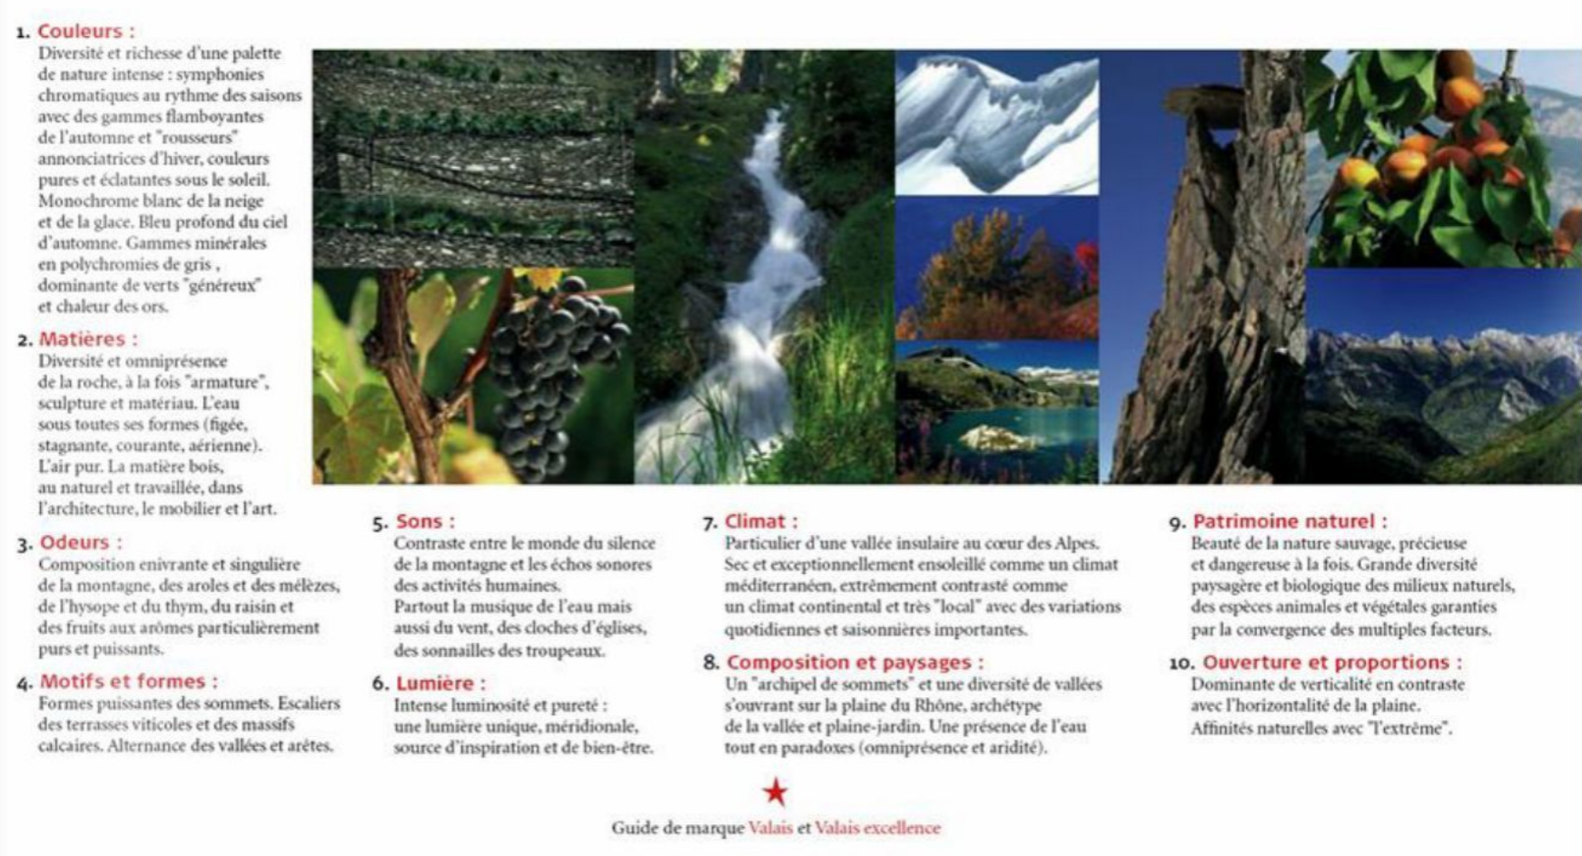
A full guide for the brand’s personality :
20 signs of identity define the physical portrait of Valais
Notes:
What is the personality of the Valais ?
What is it made of ?
What are the recognisable signs ?
Colours; Materials, Smells, Patterns and shapes, Sounds, Light, Climate, Landscape, Natural heritage, Opening and proportion

Slide 27
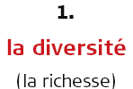
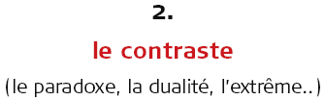
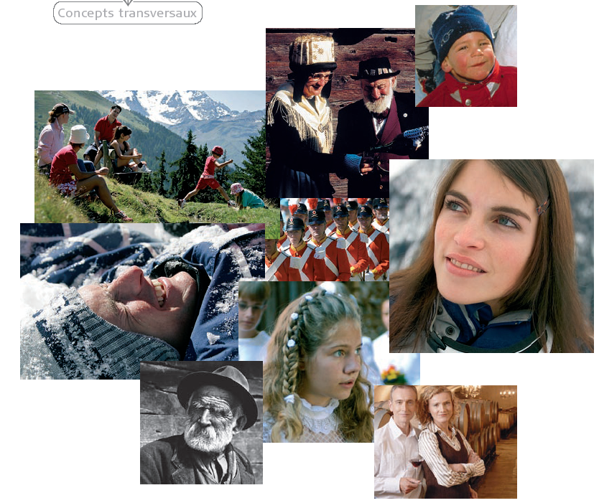
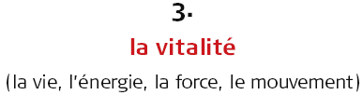
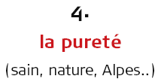
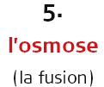
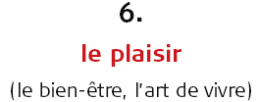
Identity portrait
6 cross-cutting concepts sum up the Valais
Notes:
As you can see, the human being is at the center of all activity !
1. Le Valais est vraiment un pays – limites géographiques – culturelles
2. Une île montagnarde paradisiaque et ouverte – on pourrait croire le Valais fermé, en réalité il a toujours été une terre de fusion et de passage.
3. La terre-source – La géologique le confirme en faisant de ce canton le creuset de la géologie alpine – visiteurs qui viennent se ressourcer chez nous – Jardin extraordinaire – jardin d’Eden (vigne)
4. Un pays composé d’hommes au caractère « montagnard latin » - Fierté de notre pays – caractère indépendant – côté bon vivant – mi-montagnard, mi-médridional

Slide 28
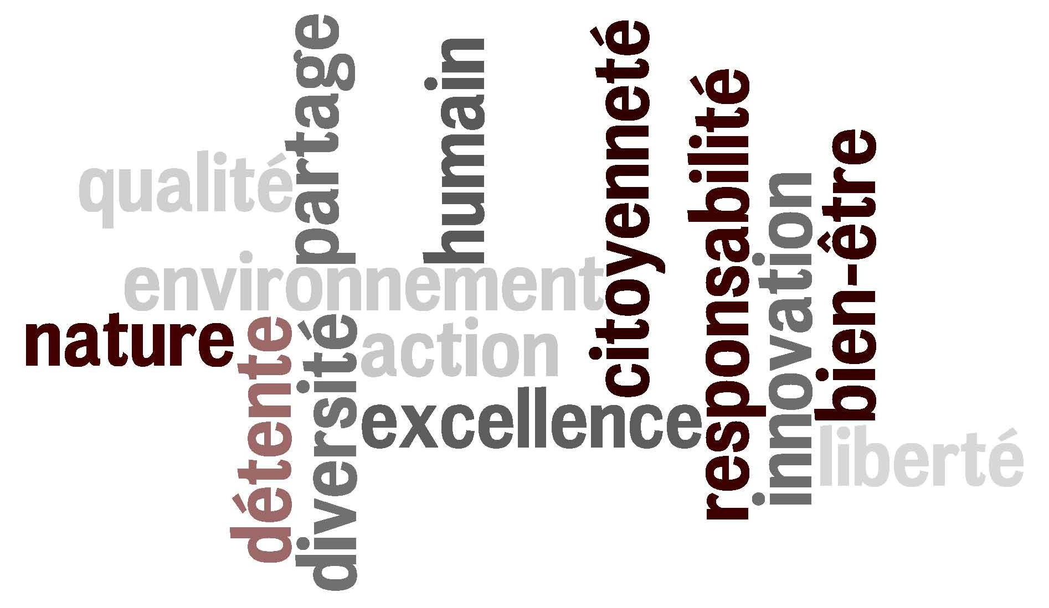
The VALUES in text
LES VALEURS

Slide 29
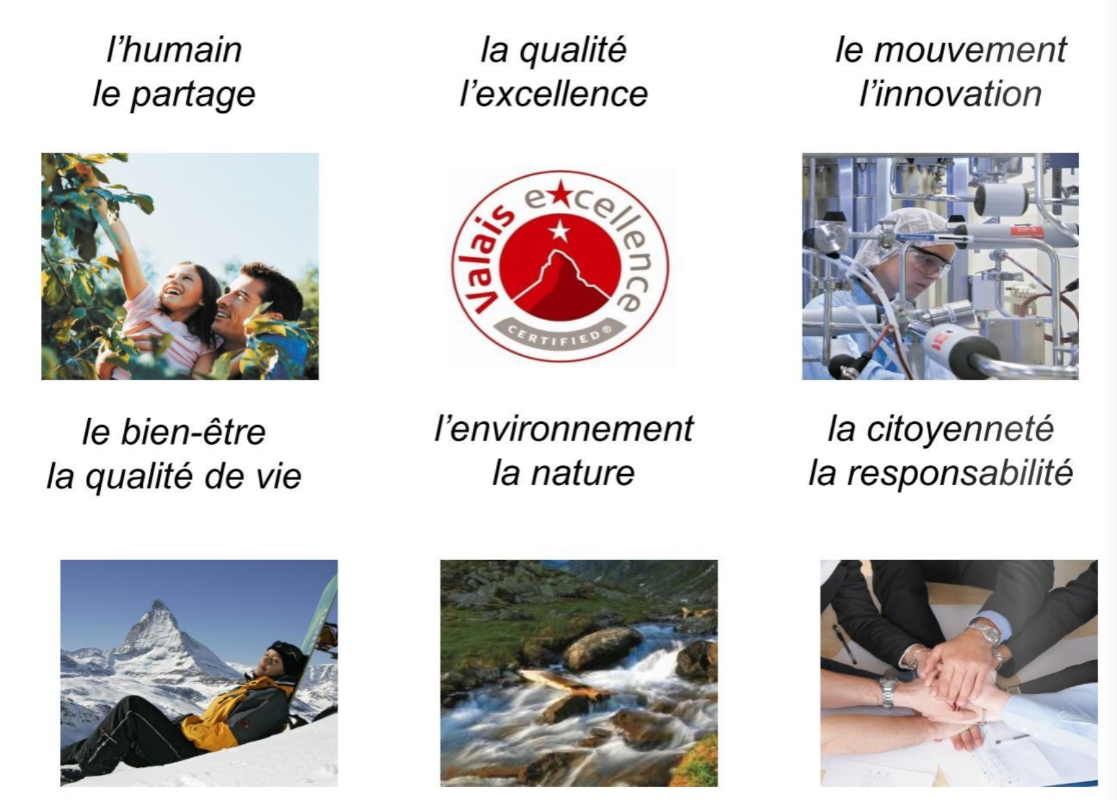

The VALUES in picture
Human beeing
Sharing
Quality
Excellence
Mouvement
Innovation
Well-being
Quality of life
Environment
Nature
Citizenship
Responsibility

Slide 30
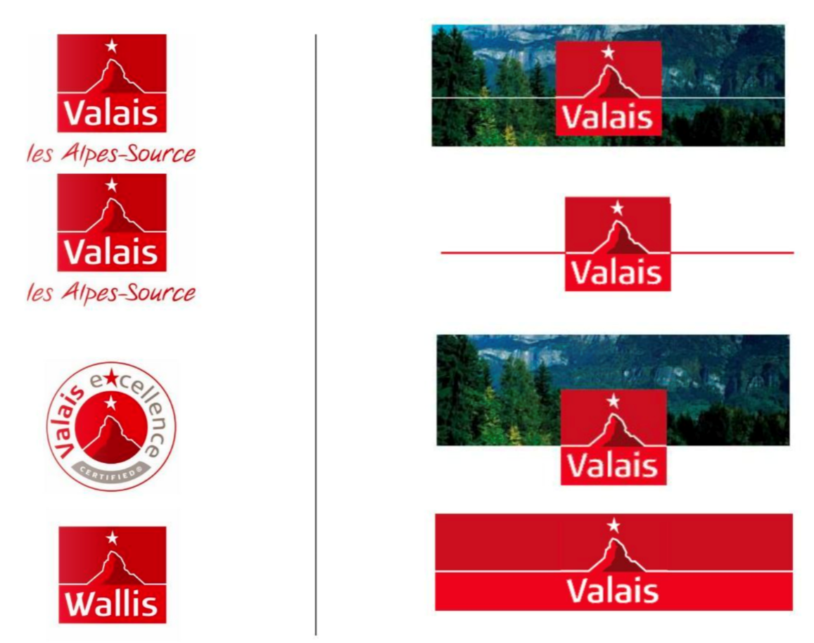
Communication : clear user information

Slide 31
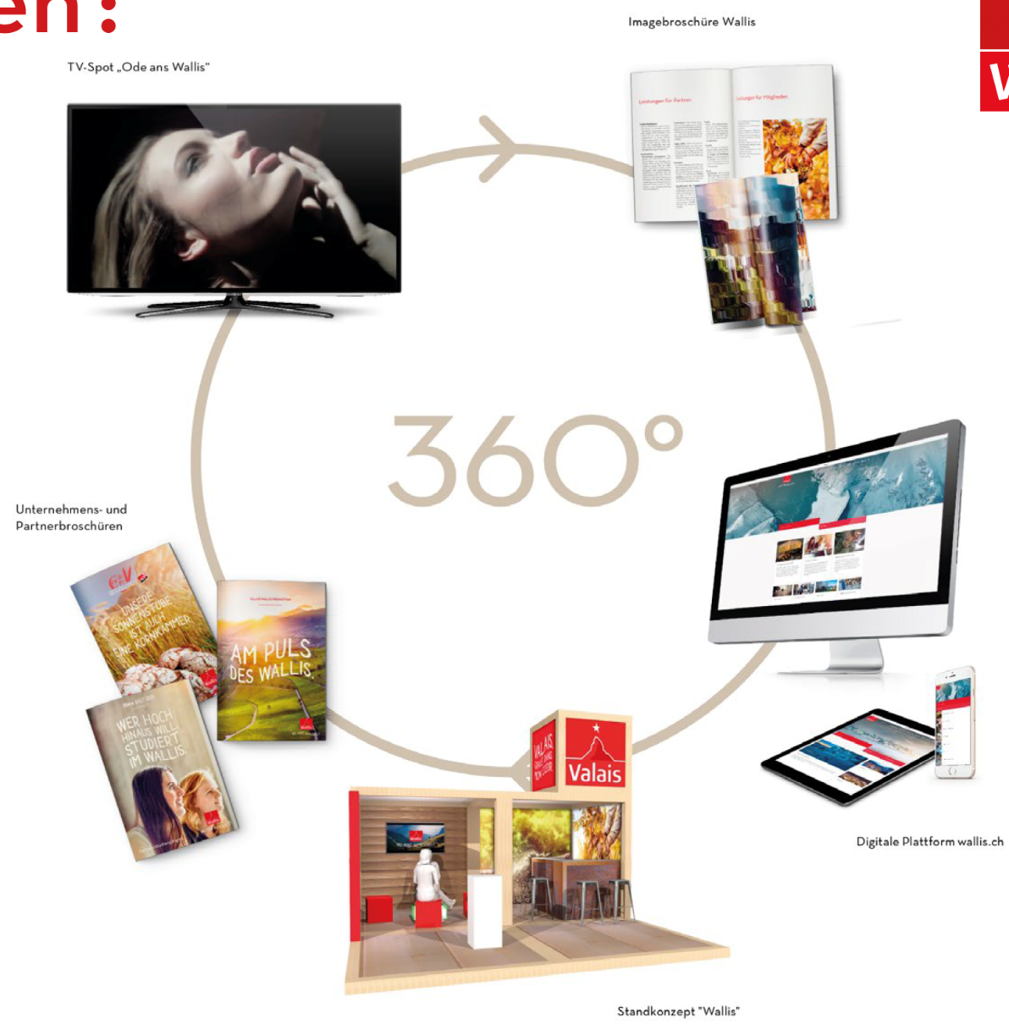
Communication : Mix Marketing 360°
Notes:
Une campagne à 360° pour le lancement de cette nouvelle ligne

Slide 32
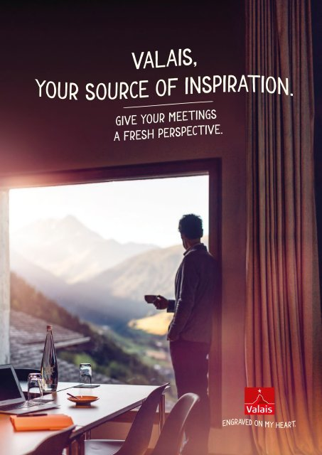
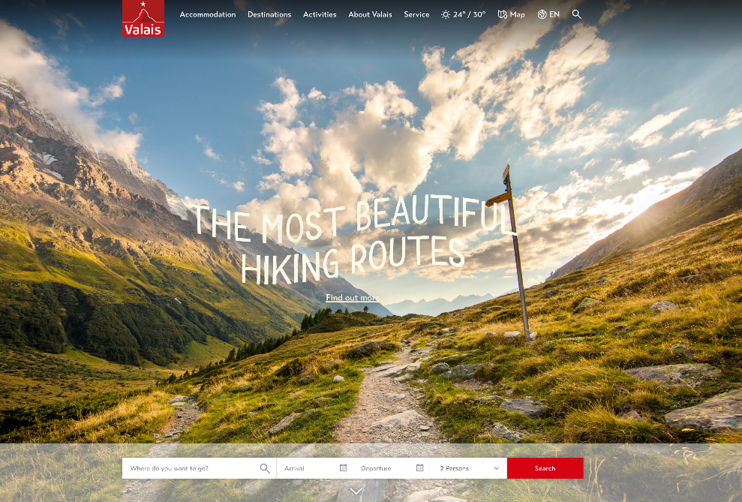
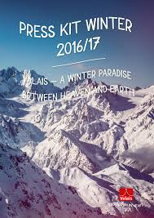
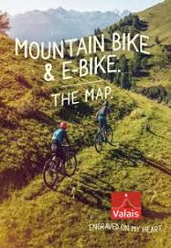
Serving the ‘tourism’ industry

Slide 33
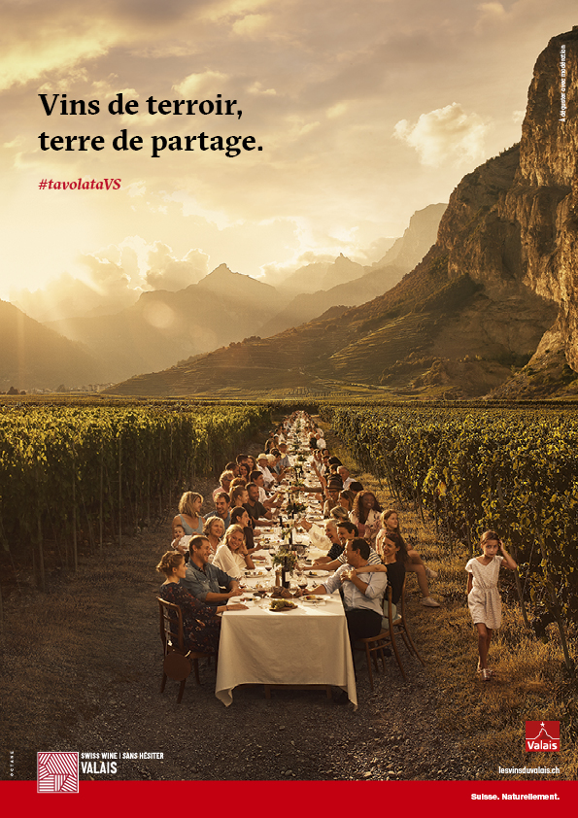
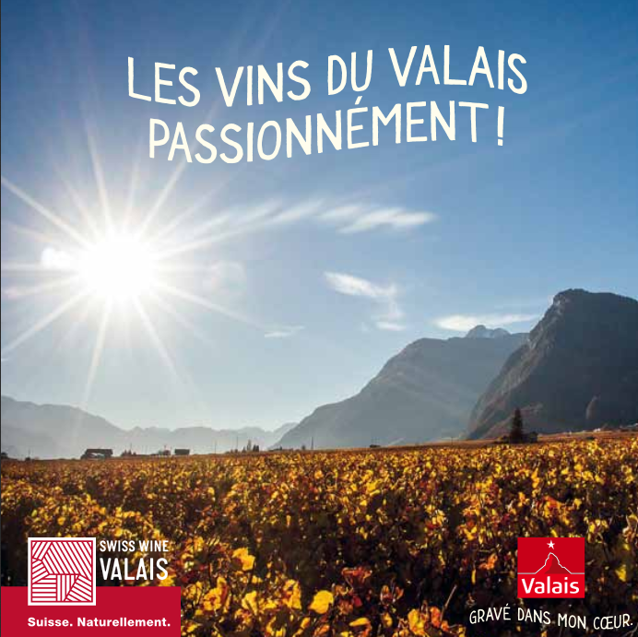
Serving the ‘wine’ industry

Slide 34
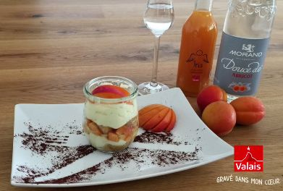
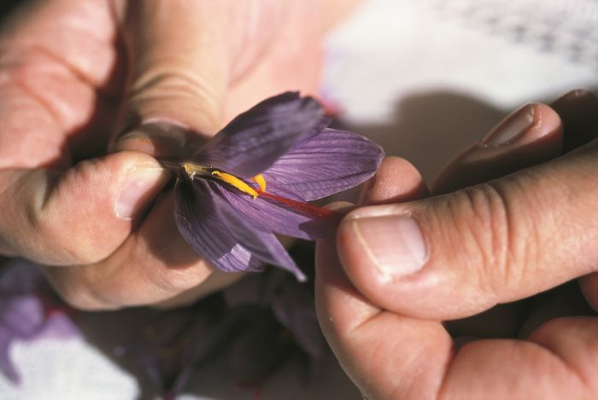



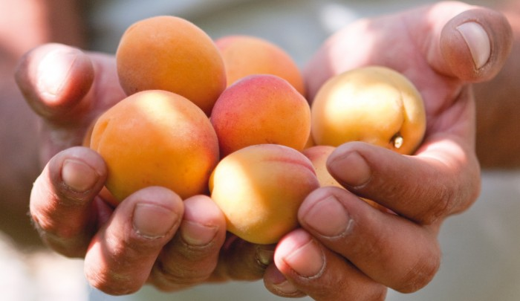
Serving the ‘agriculture’ industry in the communication
www.valais-community.ch

Slide 35
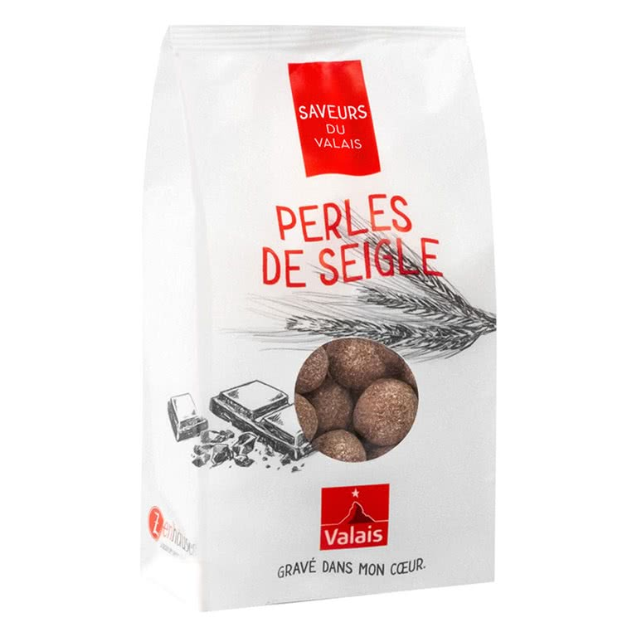
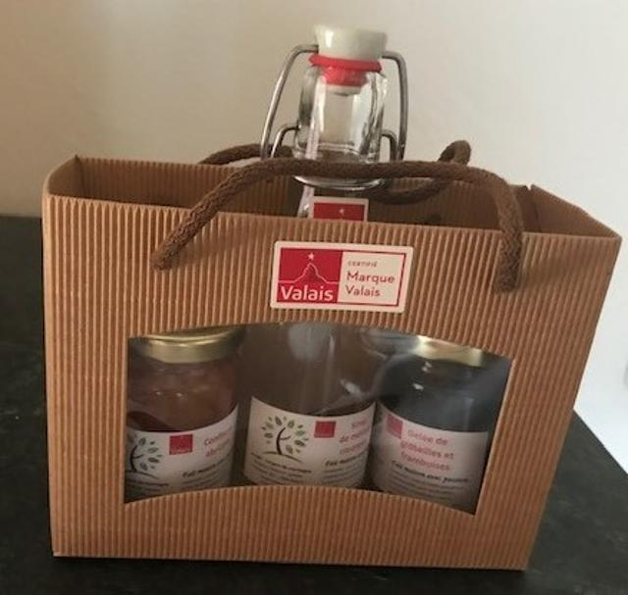
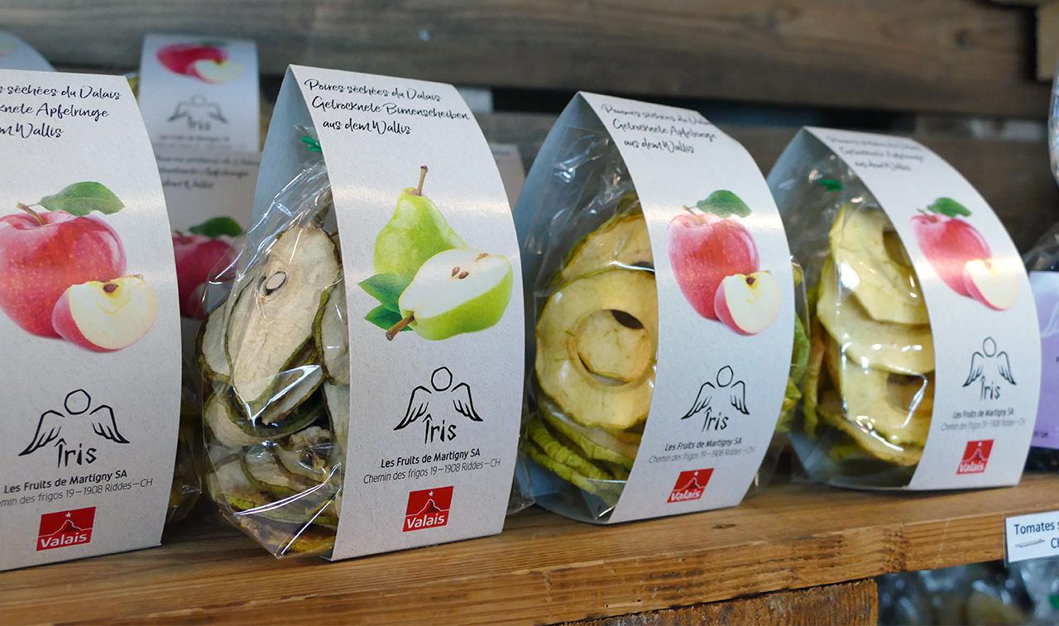
Serving the ‘agriculture’ industry in the packaging
www.valais-community.ch

Slide 36
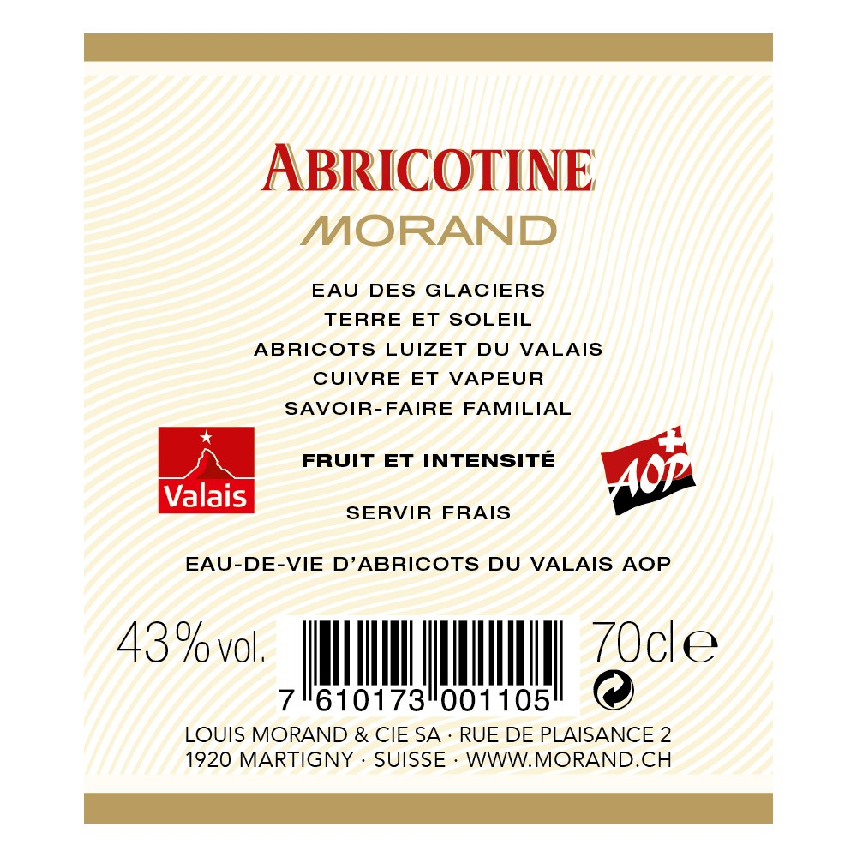

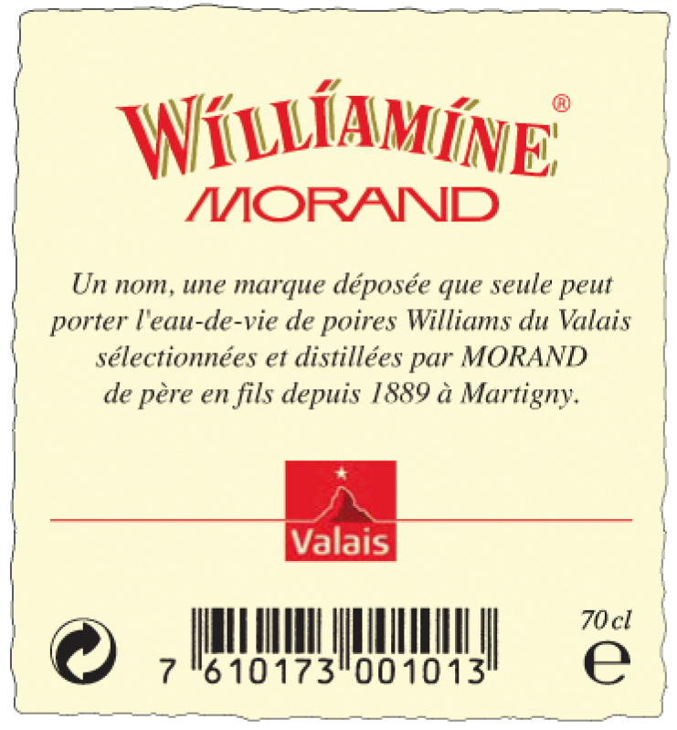
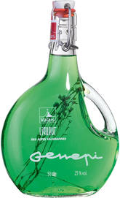

derived products from the agricultural industry

Slide 37
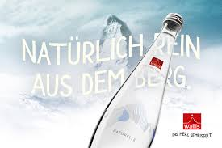
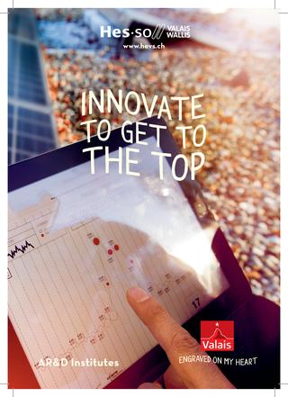




promotion of our INDUSTRIES ex : Aproz mineral water creating a ‘valais’ pure mineral water
Notes:
Hambourg crée des produits dérivés conçues par les berlinois…

Slide 38

Media presence through event sponsoring ex : Crans-Montana Omega European Masters Golf

Slide 39



Support of culture and traditions through events ex : Cow fighting final event

Slide 40

The results… a performance analyses in switzerland

Slide 41

protected awarness labels

Slide 42

Readiness to buy

Slide 43
Main learnings from the study
The 'Valais' brand is more effective than the canton's flag in promoting local products.
The 'Valais' brand is the best known of the regional labels in Switzerland (53%).
The 'Valais' brand has an excellent recognition (62%) and a high level of trust.
The 'Valais' brand is not yet perceived as a label of quality and guarantee for local products.

Slide 44

2nd step : a quality label to promote quality and sustainability in local entreprises

Slide 45







Other good practices in the alpine area :

Slide 46
Simon Sinek / The golden circle https://www.ted.com/talks/simon_sinek_how_great_leaders_inspire_action?language=pl

Slide 47


Slide 48







